Slide 1

Sales Analytics at Vrinda Store - A Case Study

Slide 2
Introduction
Vrinda Store is a fictional online fashion store that delivers clothes through popular e-commerce channels like Flipkart, Amazon, and Myntra. We have a dataset of around 31,000 customers, with information such as customer ID, gender, age, and other relevant data.
This presentation will discuss multiple insights derived from our customer dataset. We will explore the demographic breakdown of our customer base, identify key trends and patterns, and discuss how this information can be used to improve our marketing and sales strategies.

Slide 3
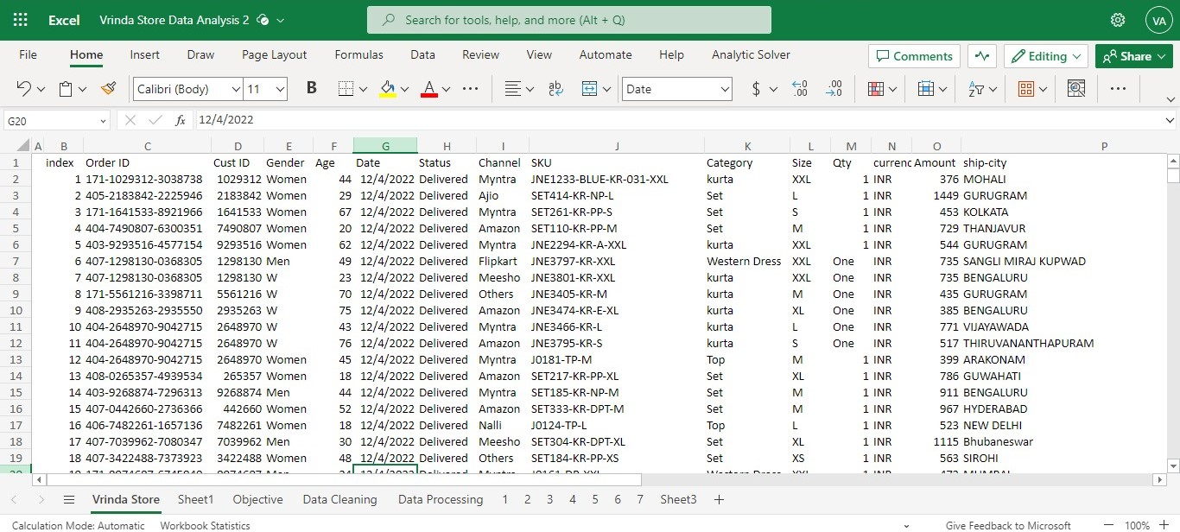
Raw Data Overview

Slide 4
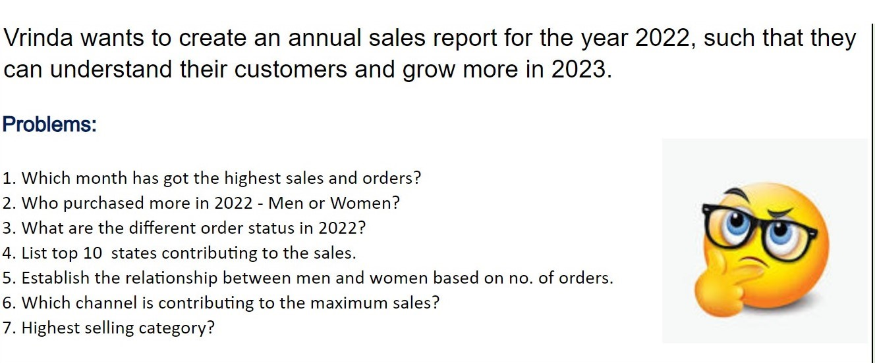
Problem Statement

Slide 5
Data Collection
This dataset is been taken from the Kaggle, one of the most widely used website for datasets used for Analytics.
Link - https://www.kaggle.com/datasets/harunshah786/vrinda-store-dataset
Shape of dataset is (31047,21).
Index, Order ID, Cust ID, Gender, Age, Date, Status, Channel (e.g., online, in-store), SKU, Category, Size, Qty, Currency Amount, Ship City.

Slide 6
Data Cleaning
Resolving Inconsistencies
Gender column: inconsistent entries (M, Men, Women, W)
Converted all entries to M and W.
Qty Column: inconsistent entries (One, Two, 1, 2, 3, 4, 5)
Converted all entries to Number.
There were no duplicates, outliers and missing values in dataset.

Slide 7
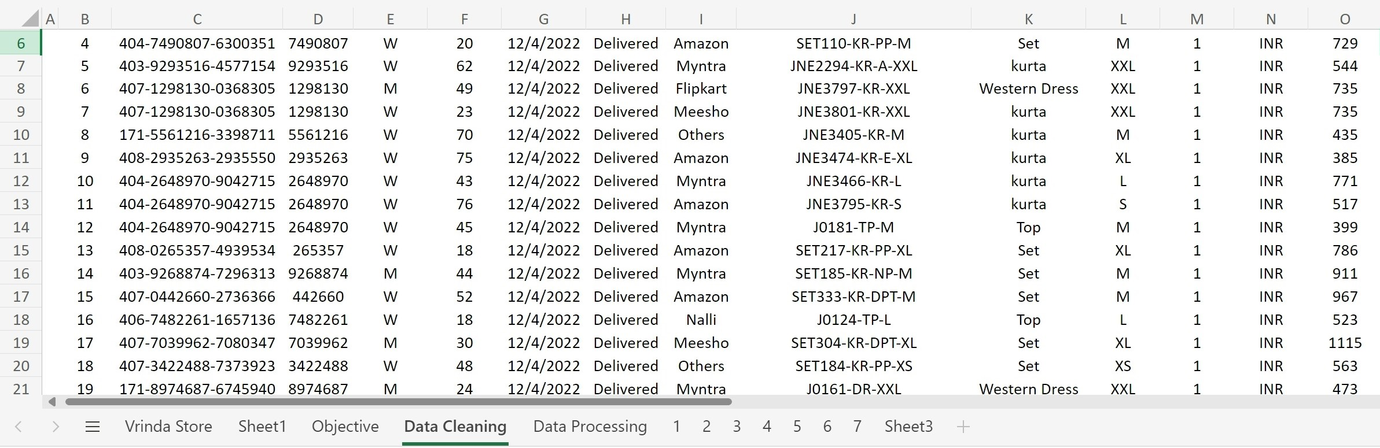
Cleaned dataset overview

Slide 8

Data Processing
Data Formatting – Introduce two more columns Age group and Month derived from age and date column respectively.
Age group is derived using nested if().
Formula:=IF(F3>60,"senior",IF(F3>19, "adult","teenage"))
Month is derived using TEXT().
Formula: =TEXT(H3,"mmm")

Slide 9
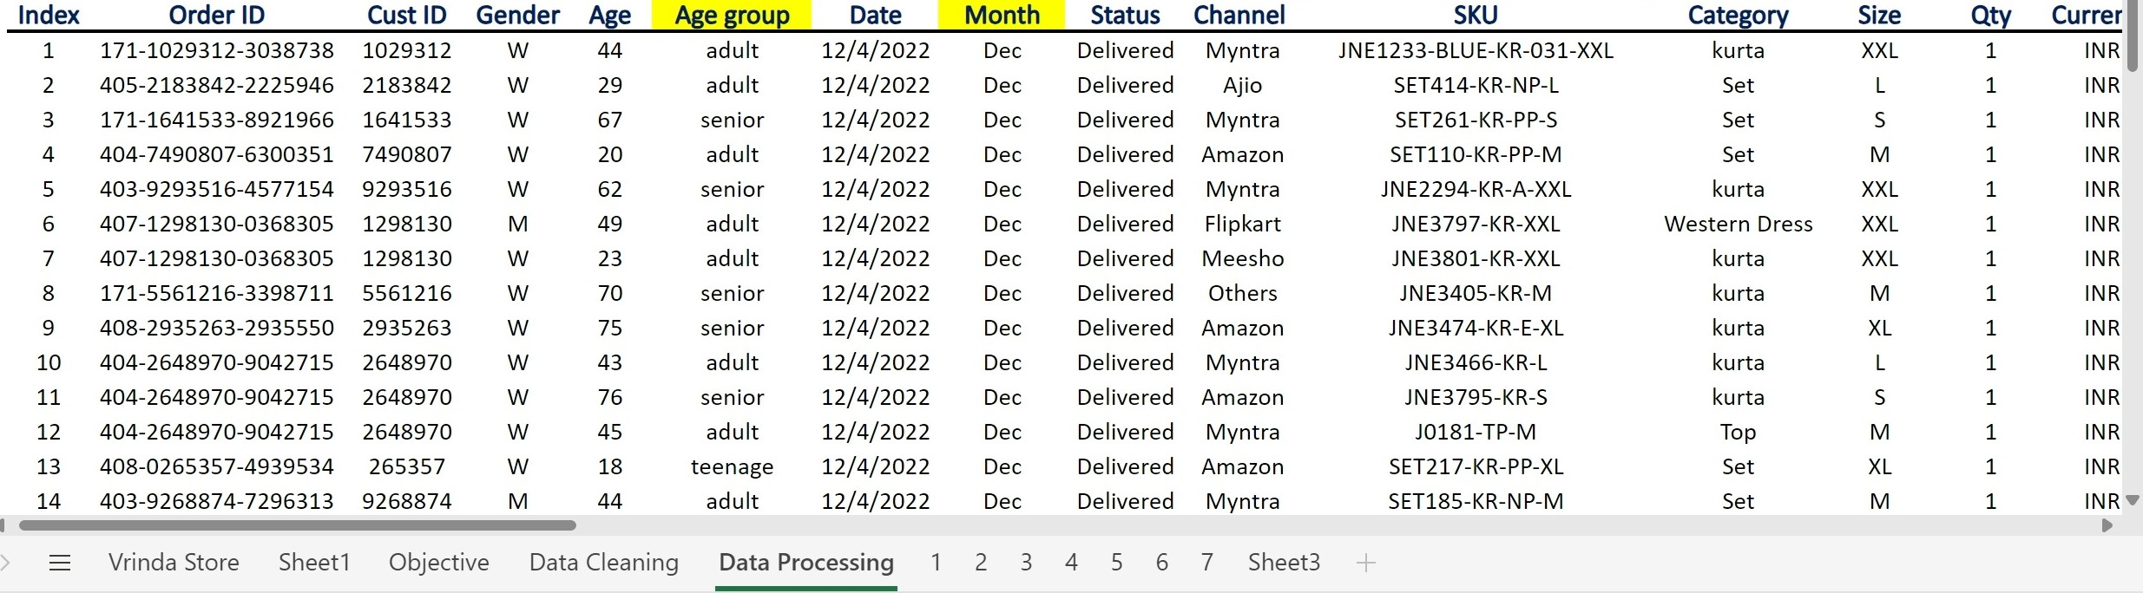
Processed dataset overview

Slide 10
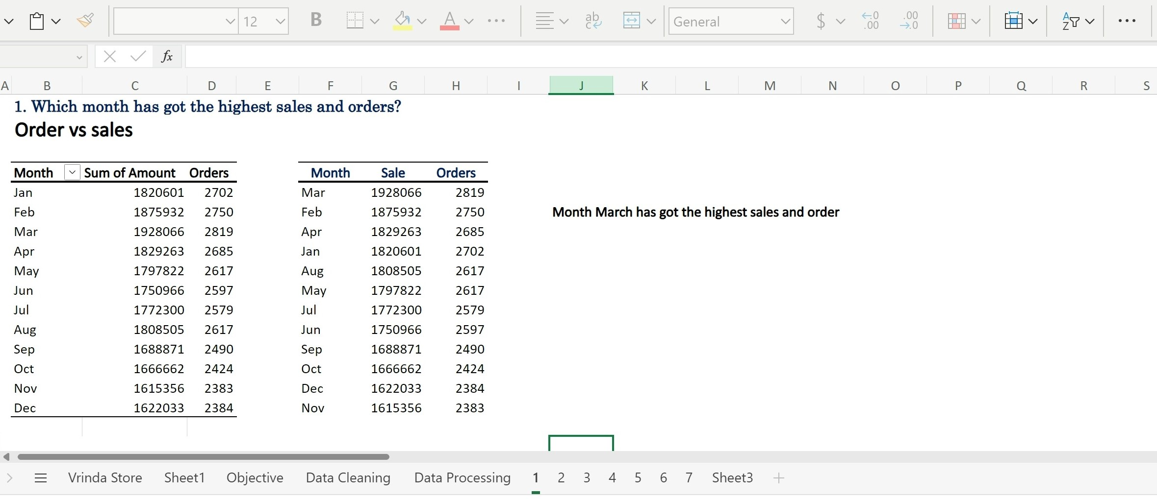

Slide 11
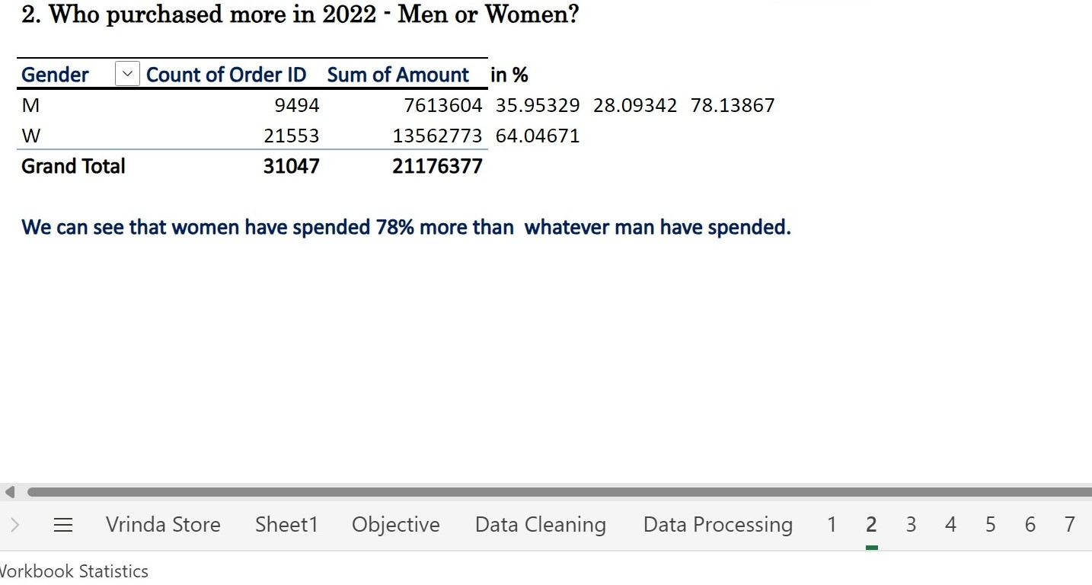

Slide 12
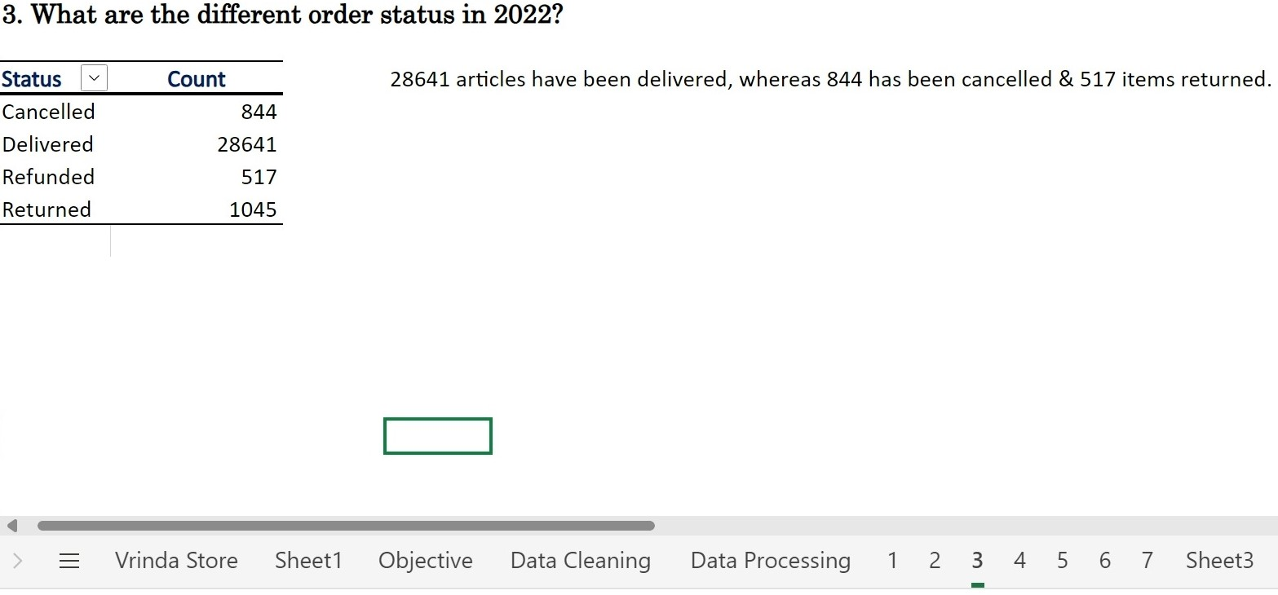

Slide 13
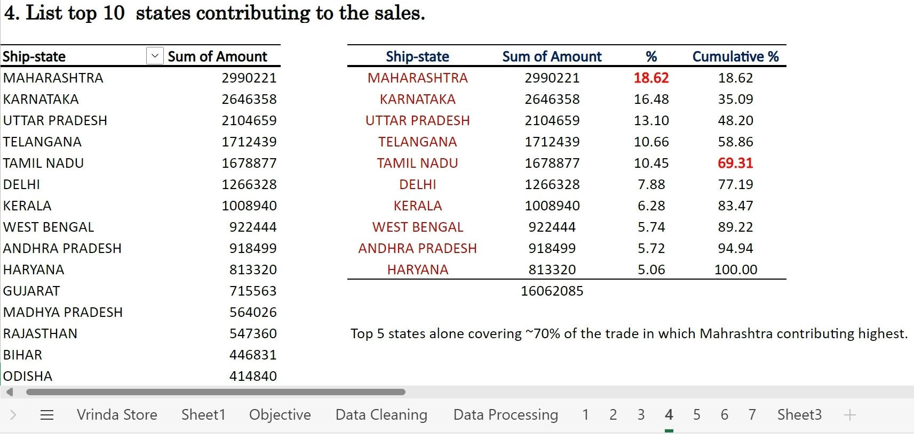

Slide 14
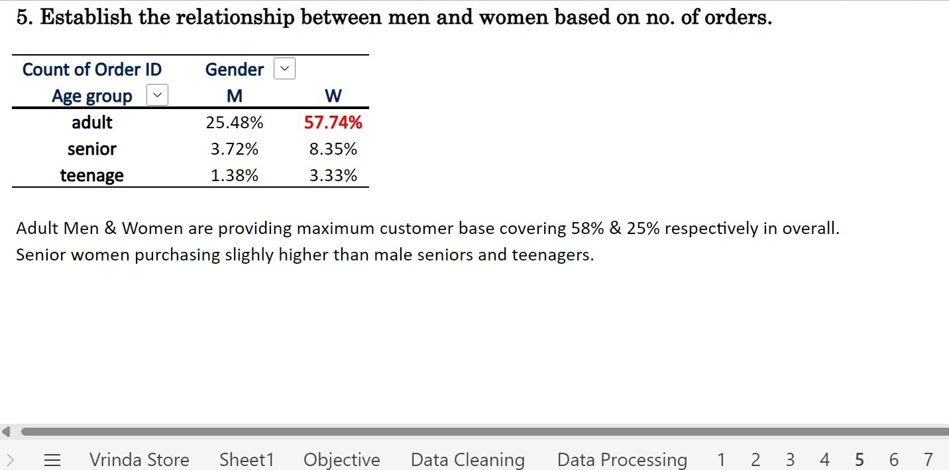

Slide 15
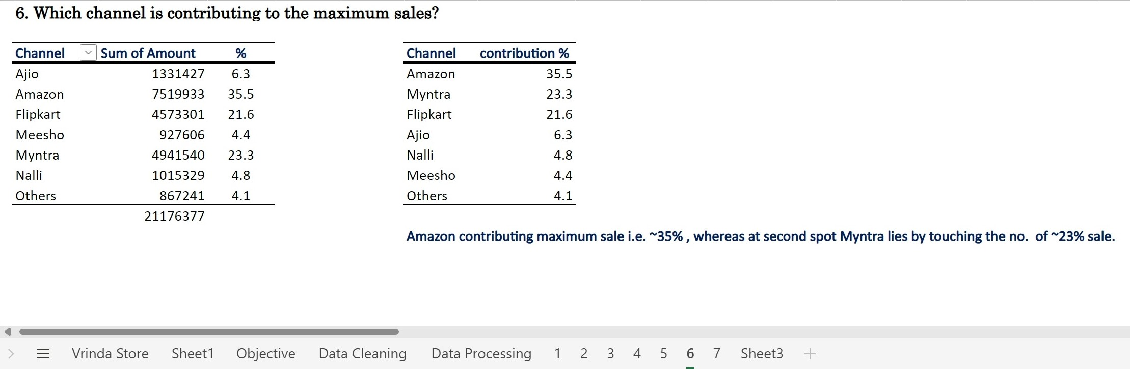

Slide 16
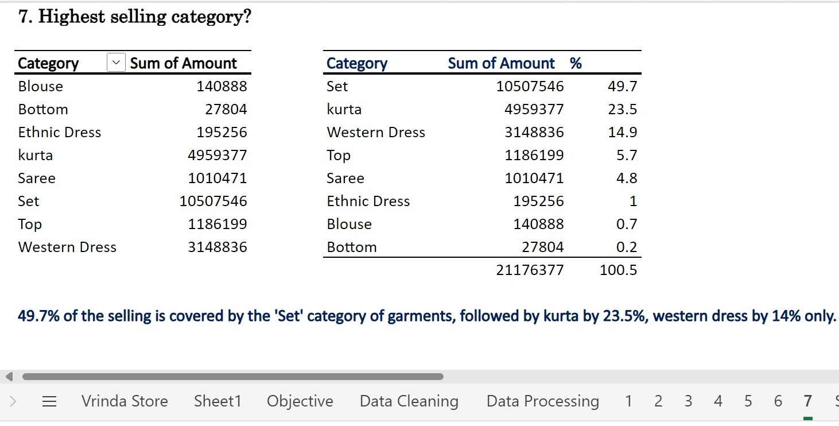

Slide 17
Conclusion: Based on all the insights, here are some recommendations for Vrinda:
Focus on marketing and promotions during March, the month with the highest sales and orders.
Develop products and marketing campaigns that appeal to women, the biggest spenders.
Expand reach in the top 5 states, which contribute to 70% of sales.
Develop products and marketing campaigns that appeal to adult men and women, the largest customer demographics.
Continue to focus on Amazon and Myntra, the top sales channels.
Expand the range of sets and kurtas, the top selling categories.

Slide 18
Certain add-ons Vrinda store should provide:
Lack of proper customer base information: If 78% of the buyers are Women implies 22% of the coverage is carried by Men. But there is no men's clothing in Vrinda store. This is the point where conclusion could be misleading. Hence company needed to research more and provide correct customer base.
Lack of information about budgeting, funding & clothing range: It is recommended to enhance market strategies, branding promotion in specified domain, expand clothing range for man counterpart also but what if company have not enough funding! What if company have not enough setup or postal services! What if company is troubling by recession! What if company have not enough manufacturing hub in those areas where it lag!
Overall only on basis of the certain assumptions, following recommendation shall be entertained otherwise it is troubled situation for data analyst.

Slide 19
By following these recommendations, Vrinda can understand its customers better and grow more in 2023
Good luck to Vrinda!
Thank you for your patience

